Slide 1
NoSQL assignment

Slide 2
Importing the data
mongoimport --db mass --collection amongus --type json --file D:\Python_Scripts\005_MS_DS\Module_assignments\04_among_us_NoSQL\AmongUsdata.json --jsonArray

Slide 3
Queries on game 3

Slide 4
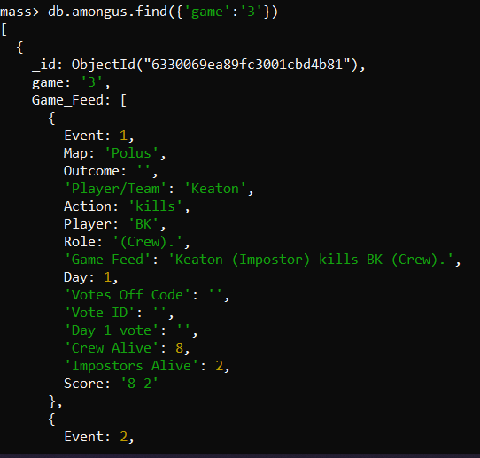
Finding records for the third game
db.amongus.find({'game':'3'})

Slide 5

Saving records of game 3
db.game3.insertMany(db.amongus.find({'game':'3'}).toArray())

Slide 6
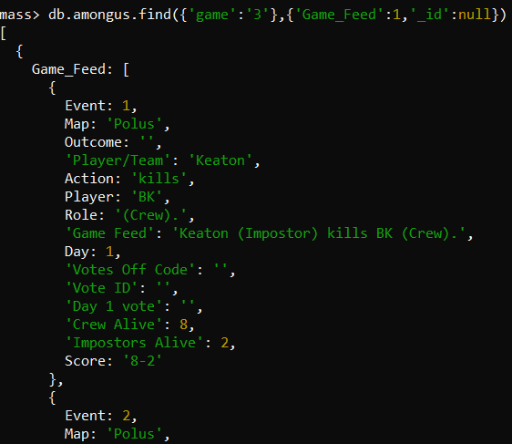
Display the Game Feed data for the game in the new collection.
db.game3.find({'game':'3'},{'Game_Feed':1,'_id':null})

Slide 7
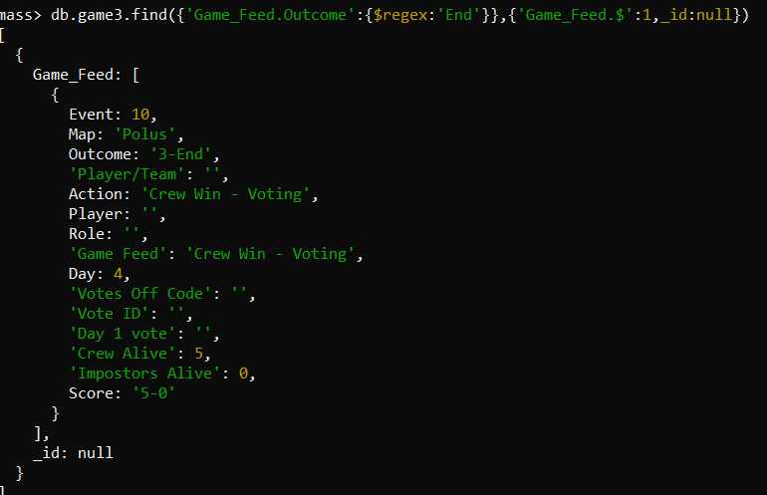
Display the last event in game 3.
db.game3.find({'Game_Feed.Outcome':{$regex:'End'}},{'Game_Feed.$':1,_id:null})

Slide 8
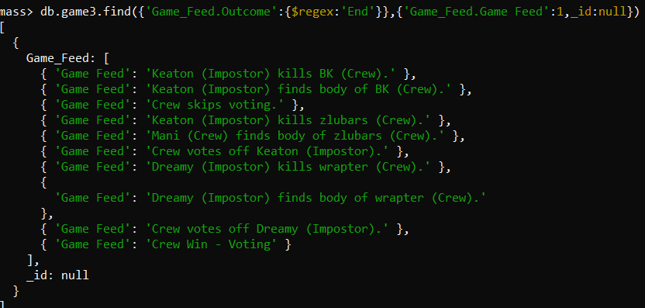
Who won game 3, imposters or crew?
db.game3.find({'Game_Feed.Outcome':{$regex:'End'}},{'Game_Feed.Game Feed':1,_id:null})

Slide 9
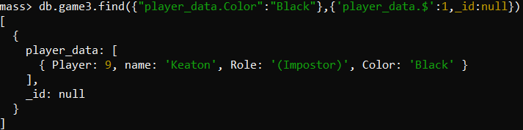
who picked black color in game 3
db.game3.find({"player_data.Color":"Black"},{'player_data.$':1,_id:null})

Slide 10
Number of voting events in game3
db.game3.aggregate({$project:{cnt:{$size:'$voting_data.Vote_Event'}}})

Slide 11
This task was focused on exploring a single document. As explained earlier the document is made of 4 main fields and three of those are nested and hold a lot of data. If you were to redesign this database to make it easier to query what changes would you make to the structure? Explain your design decisions. Do not modify the structure, simply explain the changes you want to make and justify them.
Eliminate redundant fields in nested fields. Game feed and voting events hold similar information
Remove nested nature of the collections and make separate collections for voting data and player data and use references in the game feed data

Slide 12
Aggregation queries

Slide 13
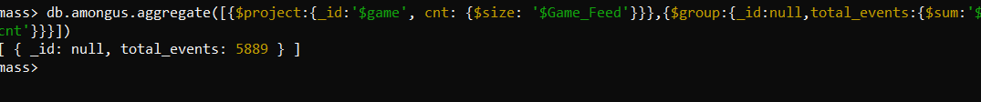
Number of events across all games
db.amongus.aggregate([{$project:{_id:'$game', cnt: {$size: '$Game_Feed'}}},{$group:{_id:null,total_events:{$sum:'$cnt'}}}])

Slide 14
How many matches did the crew win
db.amongus.find({'Game_Feed.Game Feed':{$regex:'Crew Win'}}).count()

Slide 15
How many matches did the impostor win
db.amongus.find({'Game_Feed.Game Feed':{$regex:'Impostor Win'}}).count()

Slide 16
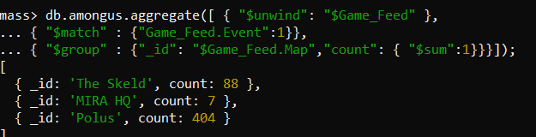
Number of matches played on each map
db.amongus.aggregate([ { "$unwind": "$Game_Feed" },
{ "$match" : {"Game_Feed.Event":1}},
{ "$group" : {"_id": "$Game_Feed.Map","count": { "$sum":1}}}]);

Slide 17

How many times in total across all games did the crew skip a vote
db.amongus.aggregate([{ "$unwind": "$Game_Feed" },
{ "$match" : {"Game_Feed.Votes Off Code":0}},
{ "$group" : {"_id":null, "count": { "$sum": 1 }}}])

Slide 18

How many times in total across all matches does the crew vote against imposters
db.amongus.aggregate([{ "$unwind": "$Game_Feed" },
{ "$match" : {"Game_Feed.Votes Off Code":2}},
{ "$group" : {"_id":null, "count": { "$sum": 1 }}}])

Slide 19
In your opinion, is the game more or less hard for impostors? Justify your answer with suitable insights from the data
Out of 499 games, the crew won 323 times while the impostors won 176 times. So game is harder for impostors
For every 10 players, there are 2 impostors. So impostors have to try harder to convince everyone during vote

Slide 20
Player Level Aggregations

Slide 21
Find the number of unique players in the data set
db.amongus.distinct("player_data.name").length

Slide 22
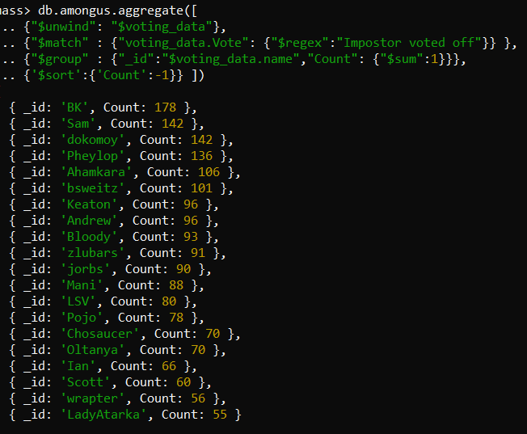
Who is the best crew member
db.amongus.aggregate([
{"$unwind": "$voting_data"},
{"$match" : {"voting_data.Vote": {"$regex":"Impostor voted off"}} },
{"$group" : {"_id":"$voting_data.name","Count": {"$sum":1}}},
{'$sort':{'Count':-1}} ])

Slide 23
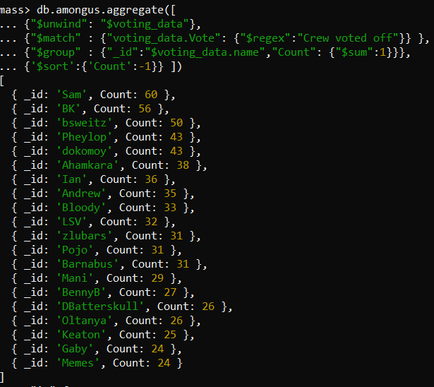
Worst crew member
db.amongus.aggregate([
{"$unwind": "$voting_data"},
{"$match" : {"voting_data.Vote": {"$regex":"Crew voted off"}} },
{"$group" : {"_id":"$voting_data.name","Count": {"$sum":1}}},
{'$sort':{'Count':-1}} ])

Slide 24
Full code can be found at the following repository
https://github.com/Satyaki9207/exploring_game_data_with_mongodb

